Slide 1

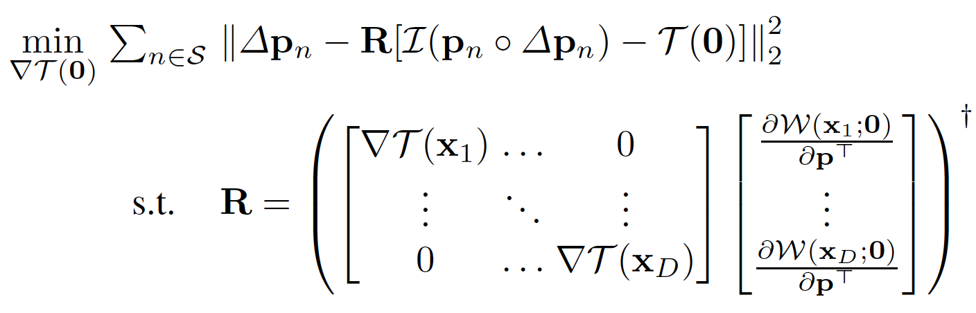
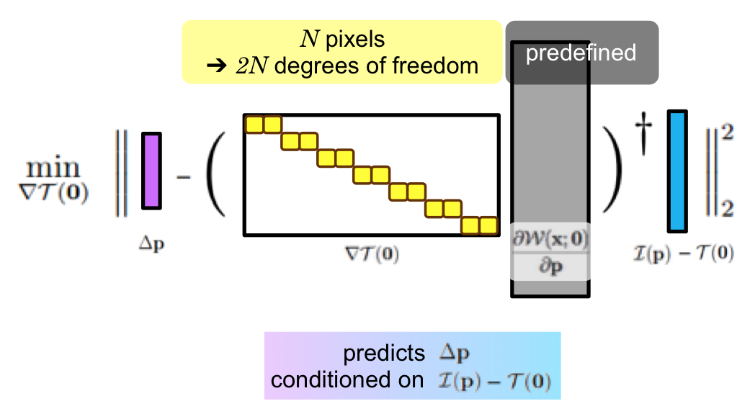
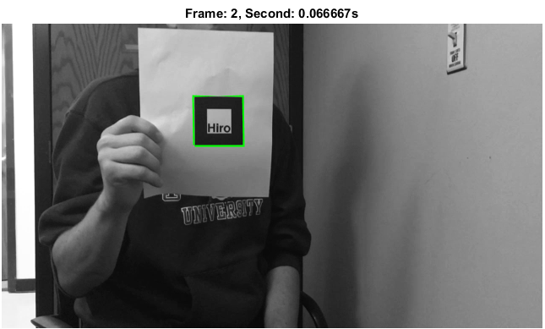
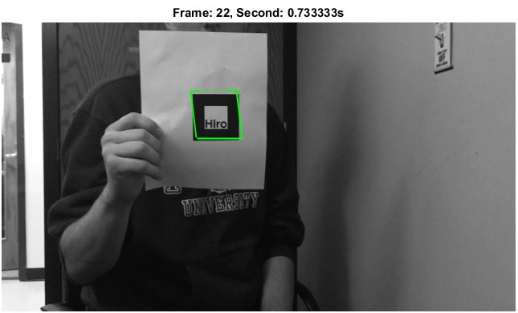
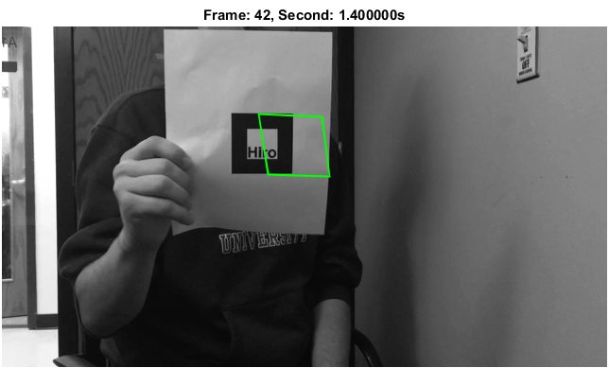
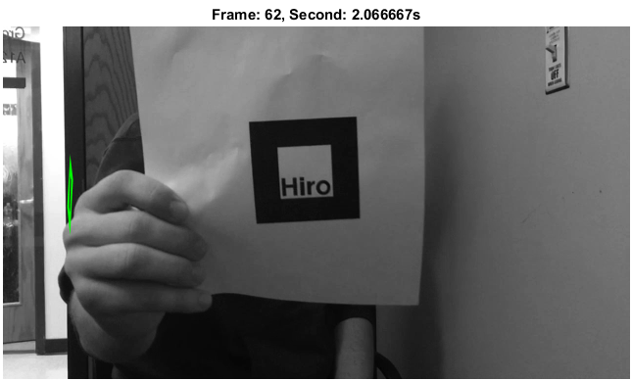
F16 16-720 Computer Vision:
Real-time Homography Estimation and Augmented Rendering
Jeremy Yen, John Ryan, Xidong Pi
Introduction
C-LK
Motivations and Goals:
Track a template image/specified object in video efficiently and accurately
Estimate the transformation matrix and augment some funny new images onto the original image or video
Investigate different tracking algorithms and compare their efficiency and accuracy
Running time & Accuracy
Methodologies & Algorithms
For tracking 100 frames in the sample video
LK-IC: 41.6582 s
KLT: ?? s
C-LK: ?? s
The accuracy for KLT tracker is obviously much better than LK-IC
C-LK ??
Specify object to be tracked by detection or by manually input
Tracking
    Lucas-Kanade Inverse Compositional (LK-IC) Tracker
    SURF/MinEigen Features + Kanade-Lucas-Tomasi (KLT) Tracker
    Conditional Lucas-Kanade (C-LK) Tracker (Lin & Lucey 2016)
Augmented Rendering
    Transformation Matrix + Alpha Blending
Real-time Demo
Input 1st image
Replace 2nd w/ next image
Replace 1st w/ 2nd image
Face Detection + Tracking + Homography Estimation + AR
Select feature points
Re-select/replace feature points
Save tracked points
Pipeline:
Examples:
Input 2nd image
Track feature points
Delete lost feature points
Input live video stream
Detection of face
Initialize transformation matrix T
Step to next frame
KLT Tracking
Fail
Succeed
Re-Detection
Experiment Results
Update T
Re-estimate T
LK-IC
Image wrapping using T
Augment image in video/α-blending
Conclusion & Future Work
KLT
Kanade-Lucas-Tomasi (KLT) Tracker works best
Estim
Inves

